Slide 1
HCC Surveillance in an Era of
Biomarkers Application of
State of the Art Tools
Robert G Gish MD
Medical Director – Hepatitis B Foundation
Principal – Robert Gish Consultants LLC

Slide 2
Disclosures
see www.robertgish.com

Slide 3
Outline and Contents
  Current global environment of HCC
      Leading cause of cancer and cancer death worldwide and in the US !
  Benefits of HCC surveillance
    HCC is curable ! With early detection
  Current practice of liver cancer surveillance
  Approved HCC Biomarkers: an overview
  Enhancement by HCC Care Using Biomarkers
  A Published HCC Surveillance Algorithm
AFP, AFPL3% and DCP are risk markers for HCC to be used for early detection
AFP, AFPL3% and DCP are not to be used to diagnose HCC
HCC is diagnosed by MR or CT, using the LiRADS score, rarely by liver biopsy not by AFP or other biomarkers

Slide 4
Hepatocellular Carcinoma: HCC
HCC in man is the 5th most common cancer worldwide.
Globally, there were >700,000 new cases and >600,000 deaths in 2018.
First leading cause of cancer-related deaths in Vietnam (~22,000/year) and VN men in the US.
Rising incidence of HCC in patients at high-risk such as viral hepatitis infection, NASH or cirrhosis.
Notes:
Hepatocellular carcinoma is the most common type of liver cancer.
As you well know, liver cancer is the most common cause of cancer death in Viet Nam.
Most cases of HCC are secondary to either a viral hepatitis infection or cirrhosis.
Over 90% of HCC in Vietnam develop in patients with background of chronic hepatitis B or C infection.
Vietnam has one of the highest rates of HBV infection in the world.

Slide 5
Progression of Liver Disease To HCC
HCC develops gradually rarely in the setting of normal liver and much more frequently as the liver injury evolves through the stages of chronic liver disease
Patients with chronic hepatitis B, fatty liver, alcoholic liver disease and hepatitis C infection and cirrhosis are identified as being at high-risk for HCC development.
Normal liver
Chronic hepatitis
Liver cirrhosis
HCC
Risk Groups for HCC
- Chronic HBV/HCV/HDV infection - Cirrhosis from any cause
- Heavy alcohol use - Metabolic syndromes: Diabetes, Obesity
- Iron overload - Non-Alcoholic SteatoHepatitis (NASH)

Slide 6
Screening and Surveillance
Screening: Application of diagnostic tests, imaging or procedures in apparently healthy patients, one time test.
Surveillance: Serial application of blood based tests, imaging or procedures in an at-risk patient population
Since the underlying risk for HCC is usually identifiable, patients who are at-risk for HCC development are highly encouraged to enroll in surveillance programs for early detection of HCC.
Notes:
This slide shows definitions of Screening and Surveillance.
Screening is application in apparently healthy patients.
Surveillance is serial application in an at risk patient population.
Early detection of HCC is crucial for the application of curative therapies and improving patient outcome. Since the underlying cause of HCC is usually identifiable, patients who are at-risk for HCC development are highly encouraged to enroll in HCC surveillance programs for early detection of HCC.

Slide 7
Recommended Groups for HCC Surveillance
Recommended Groups for HCC Surveillance
Population Group | Threshold Incidence for Efficacy of Surveillance (>0.25 LYG)(%/year) | Incidence of HCC (%/year)
Asian male hepatitis B carriers > age 40 | 0.2 | 0.4–0.6
Asian female hepatitis B carriers > age 50 | 0.2 | 0.3–0.6
Hepatitis B carrier with family history of HCC | 0.2 | Incidence higher than without family history
African/North American Blacks | 0.2 | HCC occurs at a younger age
Cirrhotic hepatitis B carriers | 0.2-1.5 | 3–8
Hepatitis C cirrhosis | 1.5 | 3–5
Sherman M. Semin Liver Dis. 2010;30(1):3-16.
Notes:
HCC develops silently. There is no opportunity for early detection by self-examination as with breast or skin cancer, nor does it call attention to itself by bleeding into a hollow organ, as bladder or bowel cancer might. Surveillance strives to detect HCC at an early stage when it is amenable to curative therapy in order to reduce mortality and is recommended in high-risk populations, most notably patients with cirrhosis.
This table identifies groups of patients in whom surveillance is likely to be effective and cost effective and for whom the American Association for Study of the Liver (AASLD) guidelines recommend surveillance.

Slide 8
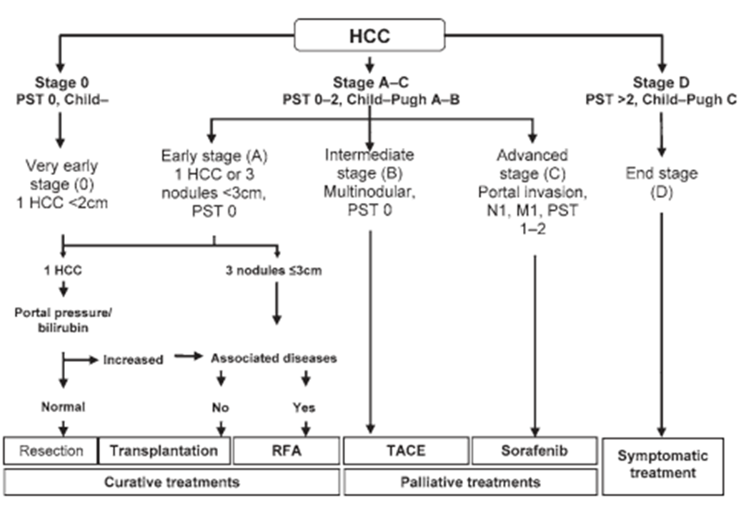
Early Detection Allows Curative Treatments BCLC algorithm
Notes:
AASLD guidelines

Slide 9
Surveillance Guidelines for High-Risk Patients
Organizations | Surveillance Recommendation
AASLD American Association for the Study of Liver Diseases | Ultrasound every 6 months
EASL European Association for the Study of the Liver | Ultrasound every 6 months (AFP denoted as risk marker)
APASL Asian-Pacific Association for the Study of the Liver | AFP + Ultrasound every 6 months
NCCN National Comprehensive Cancer Network | AFP + ultrasound every 6-12 months
VA United States Department of Veterans Affairs | AFP + ultrasound every 6-12 months
JSH Japan Society of Hepatology | AFP/AFP-L3/PIVKA-II + ultrasound every 3-6 months
AFP OPTION
Notes:
Slide 7- Global Surveillance guidelines
In the United States, the American Association for the Study of Liver Diseases (AASLD) develops and publishes the guidelines for HCC surveillance.
The current guideline recommendation for the defined high risk population is ultrasound imaging every 6 months.
The AASLD guidelines are just that, guidelines. They are a starting point for surveillance not an endpoint. They are written from the perspective of having optimal tools and focused technicians at their disposal. Unfortunately, this fails to take into account the challenges that exist for general practitioners, not the least of which include, non-specialized fair to poor quality ultrasound. Thus, real world physicians often need to find additional tools to compensate and enhance their abilities to conduct HCC surveillance.
It has been reported that <20% of at risk patients in the US are under the care of a surveillance program.

Slide 10
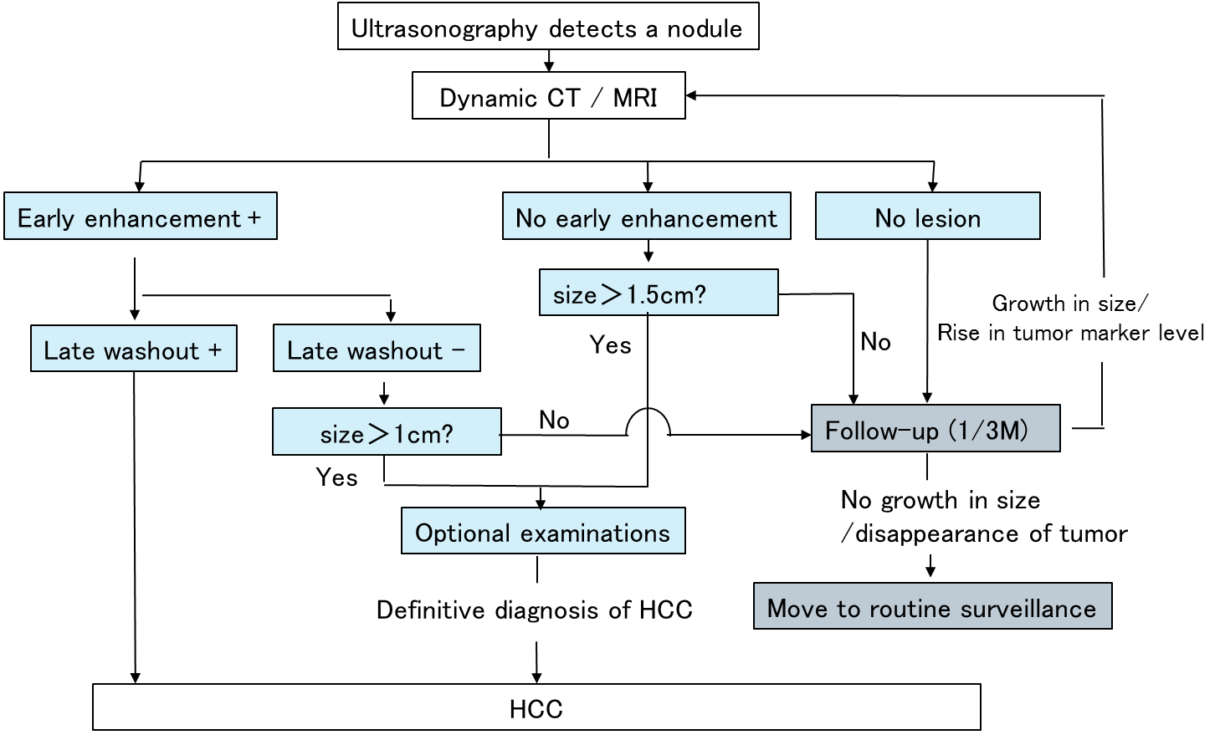
Japanese clinical practice guideline
for surveillance and diagnosis of HCC
Every 3-6 months
AFP
AFP-L3%
PIVKA-II
Notes:
日本の肝癌診療ガイドラインでは、複数の肝癌マーカー測定と超音波検査を組み合わせたサーベイランスが推奨されており、肝癌の早期診断に貢献している。

Slide 11
Imaging Modalities for HCC Surveillance
Imaging | Advantages | Disadvantages
Ultrasound | Non-Invasive Availability is ubiquitous Low cost Non-invasive | Highly operator & technique dependent -directly proportional to operator experience & skill Low Sens in Obesity Soft tissue assessment Low sensitivity in other Dis states
CT | High sensitivity Moderate to high resolution | Risk of high radiation High cost
MRI | High sensitivity High resolution | Limited availability Extremely high cost GAD accumulation
Notes:
Ultrasonography is non-invasive and low cost Imaging Modalities..
The quality of the ultrasound is operator and equipment dependent. Ultrasound quality and accuracy rapidly diminishes with obese patients and highly cirrhotic livers.

Slide 12
Ultrasound: Low Sensitivity, High Specificity
 | Primary Tool | Sensitivity | Specificity | Conclusions
Colli et al (2006)¹ | Ultrasound | 48% (95% CI 34-62%) | 97% (95% CI 95-98%) | “Ultrasound is…insufficiently sensitive to detect HCC in many cirrhotics or to support an effective surveillance program.”
Singal et al (2012)² | Ultrasound | 43.9% | 91.5% | Ultrasound is suboptimal when used alone
Colli A, et al. Am J Gastroenterol 2006;101:513-23.
Singal et al. Effectiveness of Hepatocellular Carcinoma Surveillance in Patients with Cirrhosis.
Cancer Epidemiol Biomarkers Prev May 2012 21; 793.
Notes:
Ultrasonography is non-invasive and low cost Imaging Modalities..
The quality of the ultrasound is operator and equipment dependent. Ultrasound quality and accuracy rapidly diminishes with obese patients and highly cirrhotic livers.

Slide 13
Ultrasound in HCC surveillance
 |  |  |  | Likelihood Ratio
Author | Yr | Sensitivity (%) | Specificity (%) | Positive | Negative
Okazaki | 84 | 86 | 99 | 66 | 0.14
Maringhini | 84 | 92 | 86 | 6.5 | 0.09
Kobayashi | 85 | 75 | 98 | 32.6 | 0.26
Tanaka | 86 | 47 | 100 | 589 | 0.41
Dodd | 92 | 43 | 98 | 21.5 | 0.58
Saada | 97 | 33 | 100 | 333 | 0.67
Chalasani | 99 | 59 | 92 | 8.4 | 0.45
Gambarin | 00 | 58 | 94 | 9.6 | 0.44
Rode | 01 | 46 | 95 | 9.2 | 0.57
Kim | 01 | 38 | 92 | 4.7 | 0.67
Bennett | 01 | 30 | 97 | 7.4 | 0.72
Teefey | 03 | 89 | 73 | 3.3 | 0.15
Tong | 01 | 100 | 98 | 50 | 0.0
Libbrecht | 03 | 40 | 100 | 400 | 0.5
Pooled estimates (95% CI) |  | 60.5 (44-76) | 96.9 (95-98) | 17.7 (8.5-36.9) | 0.5 (0.4-0.6)
Colli A et al. Am J Gastroenterol 2006;101:513-523
Notes:
Singal study 23-98%

Slide 14
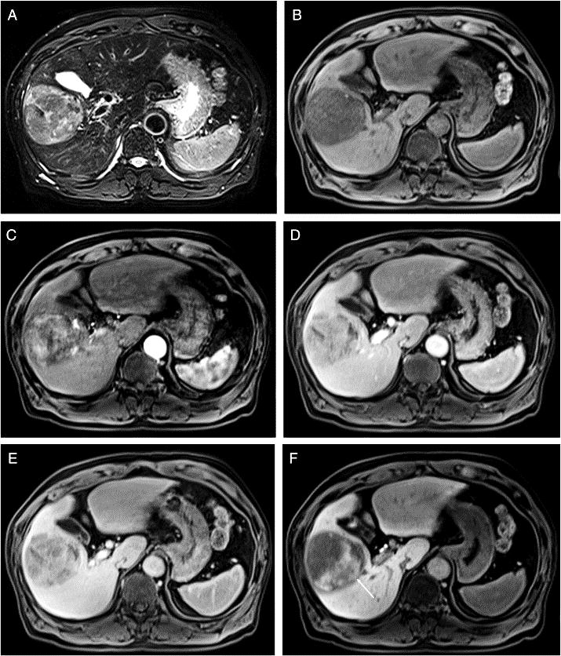
Contrast MR for Detection of Hepatocellular Carcinoma
Advantages:
High sensitivity (up to 96%)
High resolution
No irradiation
Operator independent
New Rapid test is 6 mins at 20% of the cost
Disadvantages:
Expensive
Time intensive
Patient dependent
No implants
Gad Contrast sensitivity
Requires good kidney function
High signal intensity T2 weighted image
Low signal intensity on pre-enhancement T1 weighted image
Arterial phase enhancement of mass lesion
Washout of lesion on portal phase
Washout on 2 min equilibrium
Lee SA, et al. Magnetic Resonance Imaging 2011; 29: 85-90

Slide 15
Sensitivity of HCC detection
Size | US | CT | MRI
Per-nodule | 92/200 (46%) | 126/194 (65%) | 126/175 (72%)
<2cm | 20/96 (21%) | 35/88 (40%) | 33/70 (47%)
2-4cm | 44/71 (62%) | 59/74 (80%) | 66/77 (86%)
≥4cm | 28/33 (85%) | 32/32 (100%) | 27/28 (96%)
Per-patient | 88/138 (64%) | 113/149 (76%) | 99/117 (85%)
638 Liver transplant 225 (35%) HCC,
23 excluded (infiltrative, multifocal)
Yu NC. et al Clin Gastroenterol Hepatol 2011;9:161-167
Notes:
UCLA

Slide 16
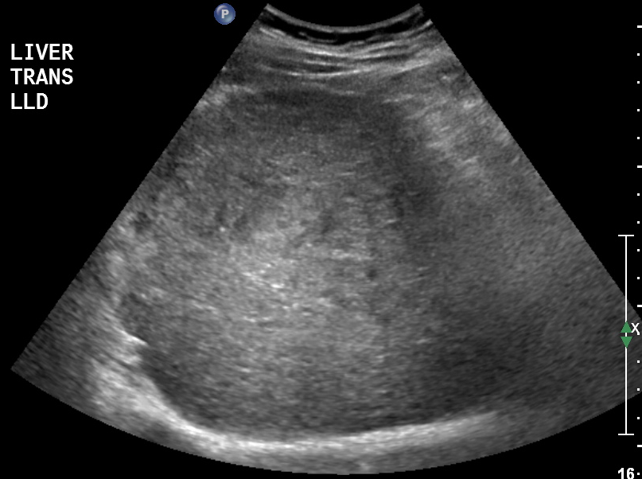
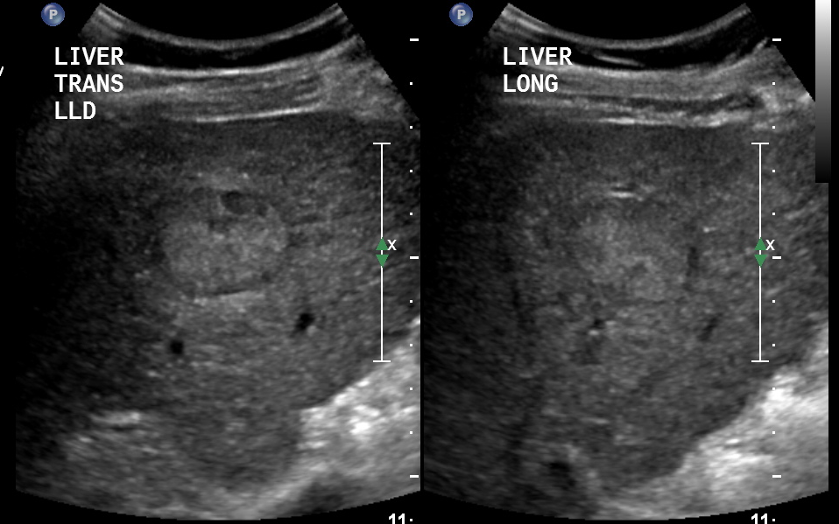
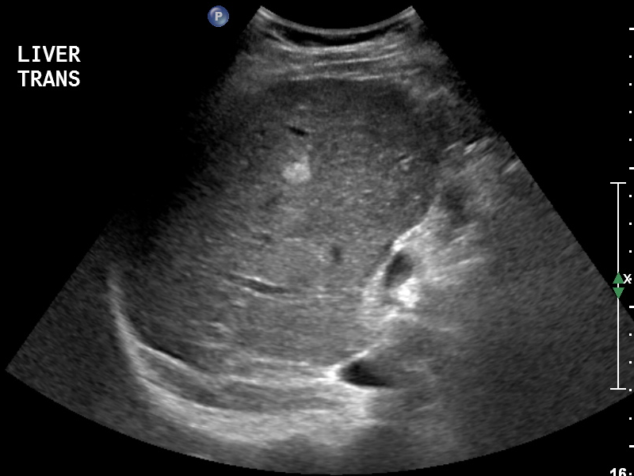
Ultrasound Images - right hepatic lobe
Well differentiated HCC (proven by biopsy)
58 year-old man, HCV cirrhosis, with known HCC s/p multiple TACE
Notes:
23292246

Slide 17
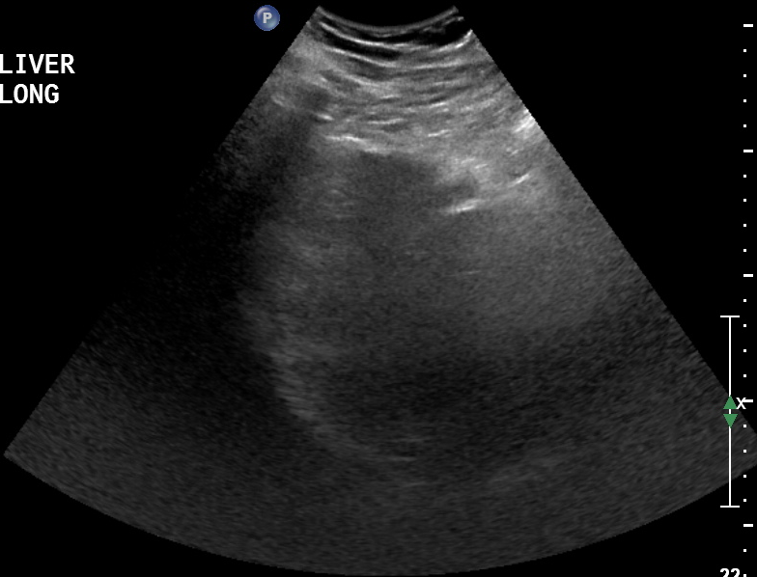
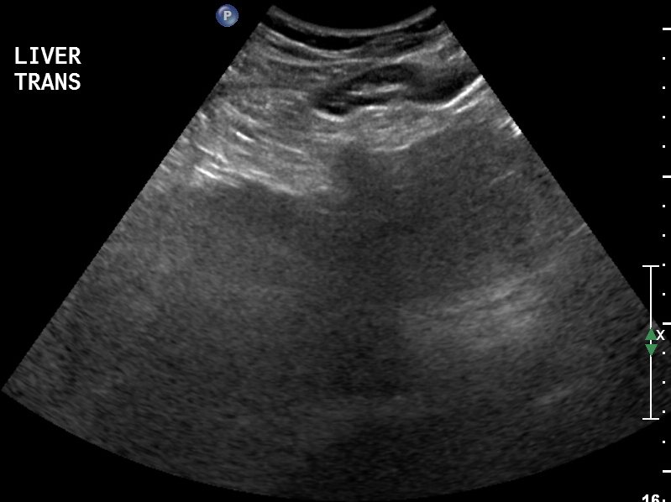
Ultrasound Images - left hepatic lobe do you see a tumor ?
58 year-old man, HCV cirrhosis, with known HCC s/p multiple TACE

Slide 18
Ultrasound is Not Ideal as a Stand-Alone Surveillance Tool
Variable quality of results
  Operator/instrument dependent¹
  Less accurate in obese patients²
  Lacks precision in patients with severe cirrhosis³
  Obesity, ascites, motion interferes with imaging
  Difficult to detect small (<2cm) lesions³
A recent survey study found that > half of the patients enrolled in surveillance programs receive a suboptimal quality ultrasound⁴
  Excellent 13/154 (8.4%)
  Good 44/154 (28.6%)
  Fair 44/154 (28.6%)
  Poor 53/154 (34.4%)
1. Bruix J et al. Hepatology. 2005;42:1208-36
2. Bruix J et al. Hepatology. 2011;53:1020-2
3. Bennett GL et al. AJR 2002;179:75–80.
4. Joshi et al. Dig Dis Sci 2014 JUL 16, In Print
Notes:
Slide 8- Why Ultrasound should be starting point for surveillance & survey data
The AASLD guideline recommended imaging modality of ultrasound is highly variable.
The quality of the ultrasound is operator and equipment dependent. Ultrasound quality and accuracy rapidly diminishes with obese patients and highly cirrhotic livers.
The ability to detect small (<2cm) lesions is poor.
To this point, a recent study conducted at the University of California San Diego found that almost 2/3 of patients that are in surveillance programs received fair or poor quality Ultrasound imaging.

Slide 19

Ultrasound Surveillance in detection of Early HCC: Systematic Review
Sensitivity %
Study 95% CI Weight
Arrigoni 1988 0.69 (0.49, 0.89) 9.60
Oka 1990 0.68 (0.54, 0.81) 11.56
Cottone 1994 0.87 (0.77, 0.96) 12.81
Zoli 1996 0.91 (0.84, 0.98) 13.41
Tradati 1998 0.33 (-0.11, 0.78) 4.30
Henrion 2000 0.67 (0.38, 0.96) 7.16
Bolondi 2001 0.82 (0.73, 0.91) 13.03
Tong 2001 0.58 (0.41, 0.75) 10.47
Santa 2003 0.25 (0.62, 0.82) 4.93
Subtotal 0.72 (0.62, 0.82) 87.27
(I² = 76.7%, p<0.0001)
Kobayashi 1985 0.50 (0.16, 0.84) 5.98
Pateron 1994 0.23 (-0.08, 0.54) 6.75
Subtotal 0.35 (0.09, 0.62) 12.73
(I² = 23.8%, p = 0.252)
0 1.0
Singal A, et al. APT 2009
Notes:
Add this slide after #93. This is from a metaanalysis of prospective studies using ultrasound for the detection of early HCC. It shows an overall sensitivity of 72%. However, when only those studies that controlled for verification bias (in red) then the overall sensitivity drops to 35%. Better quality studies are needed.

Slide 20
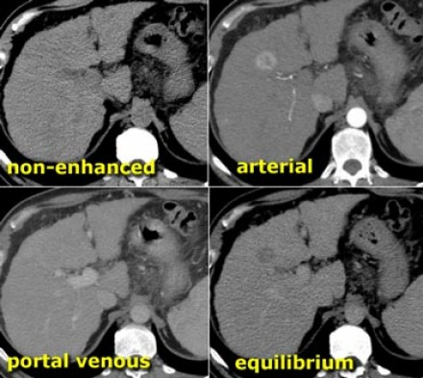
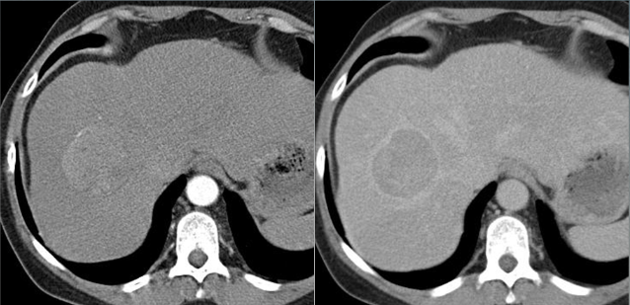
4 Phase CT Imaging
Key for LiRADS utilization

Slide 21
?CT Scan, MRI for HCC Surveillance
No evidence
Current use is only in LT centers for patient on the LT list and considered at higher risk
Pros: less operator dependent, more sensitive and specific for HCC diagnosis
Cons: expensive, limited availbility, radiation, false positive, still operator/reader dependent, cost per QALY is >250 000 $

Slide 22
HCC Diagnosis
Following Detection of Mass in Cirrhotic Liver
Repeat imaging
q 3 m
(CT/MRI/US)
Stable 18-24 m
Resume standard surveillance (q 6-12 m)
<1
cm
Enlarging
Proceed based on lesion size
Vascular Pattern
Typical
Treat as HCC
1 imaging techniques
(4 phase CT/ dynamic MRI)
>1
cm
B
I
O
P
S
Y
+
Atypical
Other contrast enhanced study (CT or MRI)
-
Repeat biopsy or Imaging f/u
Change in size or profile
Repeat imaging and/or biopsy
Atypical
Typical:
arterial hypervascularity
AND
portal venous or
delayed washout
Typical
Bruix and Sherman. AASLD guidelines. 2010
Notes:
Main point: Guidelines for HCC diagnosis following detection of mass in cirrhotic liver, by size of mass, are summarized here.
Current management guidelines for HCC do not require biopsy to prove the diagnosis
Role of liver biopsy is controversial because of concern for tumor seeding (reported rates range between 0% and 5%)
Clinical evaluation for HCC generally involves:
Measurement of serum tumor α-fetoprotein (AFP) levels
Use of imaging techniques
Ultrasound
Multiphasic computed tomography (CT) scan
Magnetic resonance imaging (MRI)
Angiography
Among the most reliable diagnostic tests include:
Triple-phase helical CT
Triple-phase dynamic contrast enhanced MRI
Presence of arterial enhancement followed by washout has sensitivity and specificity of 90% and 95%, respectively
Only focal hepatic mass with atypical imaging findings or focal hepatic mass detected in a noncirrhotic liver should undergo biopsy
References
Bruix J, Sherman M. Hepatology. 2005;42(5):1208-1236.
NCCN Practice Guidelines in Oncology. Hepatocellular Carcinoma. Available at: http://www.nccn.org/professionals/physician_gls/PDF/hepatobiliary.pdf. Accessed 22 April 2010.

Slide 23
Contrast CT vs MRI for early detection
Meta-analysis of 40 studies on CT or MRI imaging,
total of 1135 patients with CT and 2489 patients with MRI
 | CT | MRI (all) | MRI with Eovist
Per-patient sensitivity | 83% | 88%
Per patient specificity | 81% | 94%
Per lesion sensitivity | 72% | 79% | 87%
Lee, et al. Radiology. 2015.

Slide 24
Why is HCC Surveillance Beneficial?
HCC Treatment Options: Earlier is Better
Tumor Diameter at diagnosis
~ 1 cm
2 cm
3 cm
5 cm ~
Tumor Diameter
Japan
Surveillance
USA Surveillance
USA
referred base
no surveillance
2-4+cm
>5cm
Curative treatment
Resection, Transplantation,
Microwave/RFA
DEB TACE, TARE, cTACE, Sorafenib
Targeted, IO or Palliative
treatment
Notes:
Surveillance is the serial, periodic observation and conduct of appropriate tests for a particular disease state. The results are then examined for changes from baseline, previous examination or normal levels that would indicate disease progression.
This differs from screening which would be the one time testing of a general population, think tests for autosomal genetic disorders.
Q: Why is surveillance for the risk of developing HCC beneficial to the patient?
A: The earlier you catch a tumor in its development, the more treatment options that are available, including potentially curative options.
Smaller tumors can be treated by local ablative methods, resection and transplant. Larger tumors only allow for the possibility of palliative care.
Transplants typically have a ceiling of maximum tumor size. The Milan Criteria limits transplant to those with a single tumor <5cm or no more than three lesions in which the largest is ≤ 3 cm. Transplant programs utilizing these or similar criteria yield greater survivability.
Large medical centers within the USA conduct surveillance programs and typically will detect tumors in the 2-4 cm range. While at remote practices or referral sites within the USA, surveillance is often not routinely performed. The tumor sizes observed at diagnosis at these remote clinical sites are usually larger, often >5cm and only allow for palliative treatment.

Slide 25
Clinical Use of HCC Biomarkers RISK
Surveillance
Diagnosis
Treatment
Recurrence
Death / Survival
Risk assessment of HCC development
Early diagnosis and Risk/prognosis
Risk : Prediction of recurrence
FDA (United States) allows only risk-assessment use but Japanese Guidelines recommends usage of HCC biomarkers for both surveillance and monitoring after treatment.
Notes:
HCC biomarkers have mainly three roles for patient management.
“Risk assessment of HCC development” for patients at high risk for HCC
“Early diagnosis and prognosis” Elevated biomarkers can be a trigger to do CT/MRI, and also high level of biomarkers at diagnosis is associated with poor outcome.
“Prediction of recurrence” for follow-up for patients after treatment

Slide 26

Management of Patients Using HCC Biomarkers
Enrollment
Diagnosis
Treatment
Recurrence
Death/Survival
Screening is the
First test
Surveillance
Monitoring
Imaging,
Markers
Imaging,
Markers
Imaging,
Markers
Imaging,
Markers
Patients after treatment
HCC Biomarkers are also useful for patients after treatment to predict their outcome in conjunction with imaging modalities.
Notes:
Patients at high risk for development of HCC should be monitored by imaging modalities and HCC biomarkers at regular interval.
Similarly, even after treatment, patients needs to be monitored to predict recurrence and/or their outcome.

Slide 27
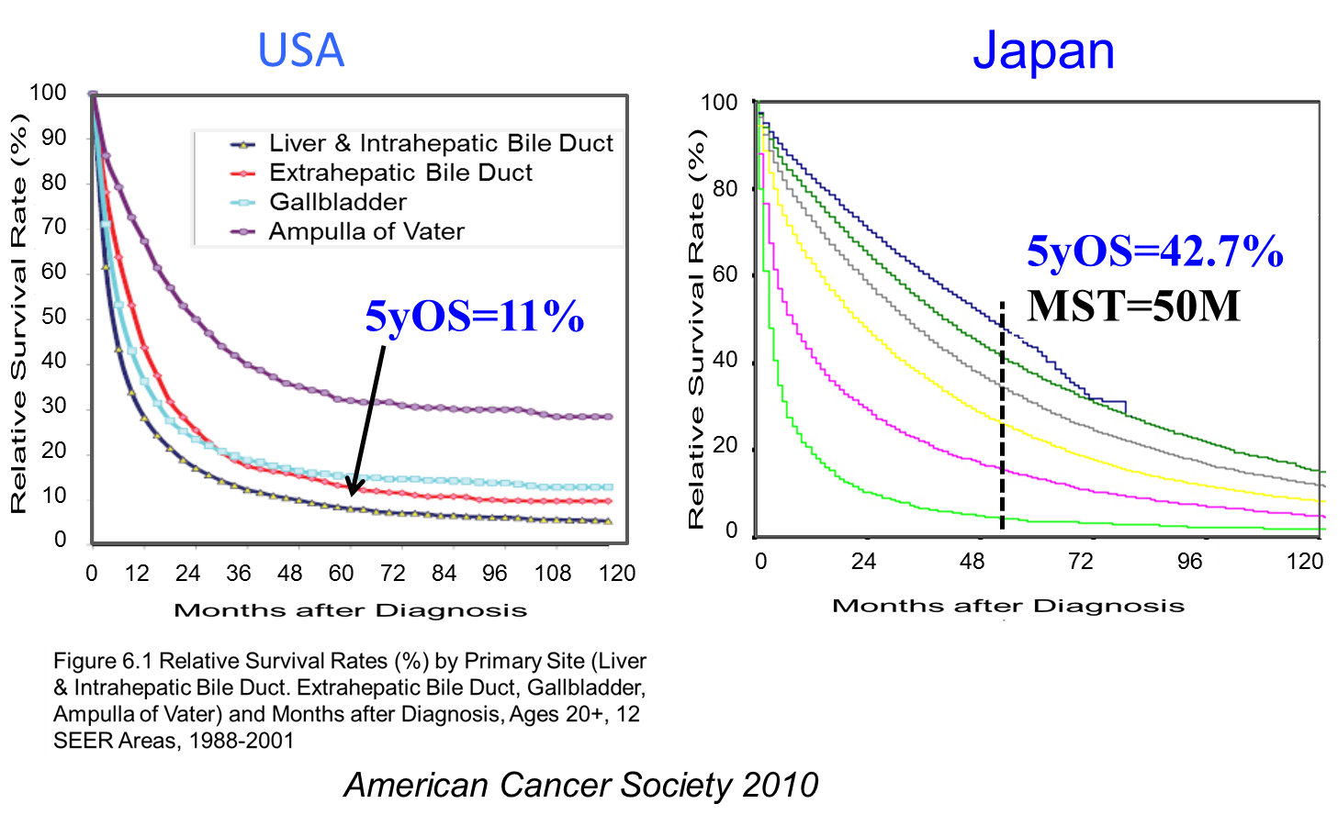
5 year survival rate comparison
JAPAN uses UltraSound/Triple biomarker panel
American Cancer Society 2010

Slide 28
Average Tumor Size at HCC Diagnosis in Vietnam
Tumor Diameter at diagnosis
~ 1 cm
2 cm
3 cm
5 cm ~
Tumor Diameter
Japan
USA
Europe
Viet Nam
60-65% : BCLC –C or D
(Advanced/End)
30%: BCLC-B (Intermed.)
10%: BCLC-A (Early)
Pham Hoang Phiet , APPLE meeting 2011
Reasons for regional differences
Experience
Attitudes of patients
Awareness of surveillance
Imaging technique
HCC biomarkers
Notes:
The majority of HCC patients are in advanced stage of disease at the time of diagnosis in Vietnam.
According to the BCLC staging classification, roughly, about 60% in end stage and advanced stage at time of diagnosis.
The treatment will be not very effective in these patients.
In Japan, liver cancer patients are diagnosed in an early phase compared to the other areas.
Because of very sophisticated program to find and treat patient in an early phase.

Slide 29

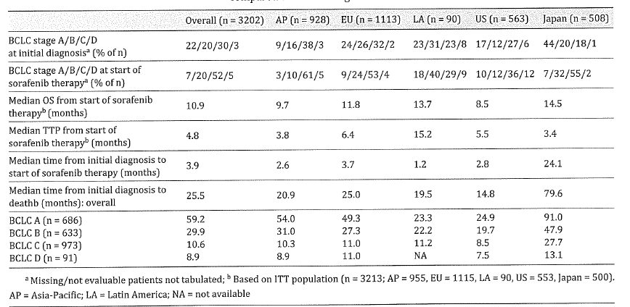
Japan
91% BCLC A
Liver Cancer 3(2) 143 (2014)
Notes:
This table shows result of global prospective study about evaluating patients with unresectable HCC treated with sorafenib.
BCLC stage A and B are early stage.
In the US, early stage was 54%. In comparison, in case of Japan, early stage was over 60%.
Median time from initial diagnosis to sorafenib therapy is 24monthes in Japan.
Median time from initial diagnosis to death in Japan is 80monthes in Japan.
The patient in Japan tend to diagnosed earlier and receive a greater number of treatments compared with other regions.

Slide 30
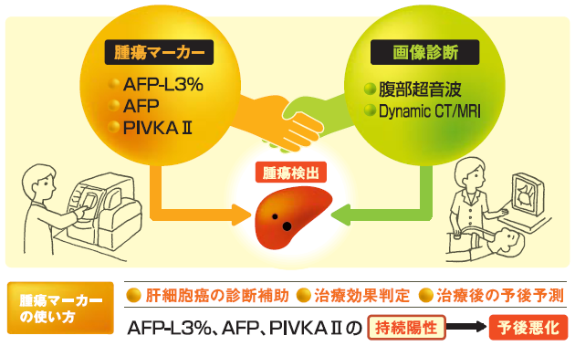
HCC Surveillance in Japan
Ultrasound and AFP/PIVKA-II (DCP)/AFP-L3% every 3-4 months for high-risk patients
Enhanced CT/MRI to diagnose HCC for patients with mass on US imaging, AFP > 200 ng/mL,
PIVKA-II(DCP)> 40 mAU/mL, or AFP-L3% > 15%
Biomarkers
Imaging
Ultrasound
Izumi N. Oncology. 2010 78 (Suppl. 1);78-86

Slide 31
Is Surveillance “Worthwhile”?
Western Standards
How do we define“worthwhile”?
  Improvement in survival of at least 3 months ^{[1]}
Surveillance considered cost-effective if it achieves 3-month improvement in survival at a cost of <$50,000 per quality life-year saved ^{[2]}
Efficacy of surveillance is determined by RCT
Cost efficacy is determined by modeling studies
  Real data if possible
  In the absence of real data
    Plausible ranges of data with sensitivity analyses
Naimark D, et al. J Gen Intern Med. 1994;9:702-707.
Laupacis A, et al. CMAJ. 1992;146:473-481.
Notes:
The quality-adjusted life year (QALY) is a measure of disease burden, including both the quality and the quantity of life lived.[1][2] It is used in assessing the value for money of a medical intervention. The QALY model requires utility independent, risk neutral, and constant proportional tradeoff behaviour.[3]
The QALY is based on the number of years of life that would be added by the intervention. Each year in perfect health is assigned the value of 1.0 down to a value of 0.0 for death. If the extra years would not be lived in full health, for example if the patient would lose a limb, or be blind or have to use a wheelchair, then the extra life-years are given a value between 0 and 1 to account for this.[citation needed] Under certain methods, such as the EQ-5D, QALY can be negative number.

Slide 32
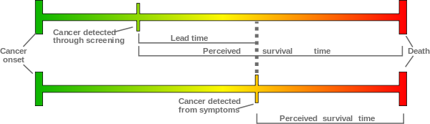
Lead Time Bias and Cancer Screening
http://en.wikipedia.org/wiki/Lead_time_bias
Notes:
Stage Migration, overdiagnosis
When we talk about cancer screening, we need to be aware of lead time bias and length time bias.
Lead time bias means that if those diagnosed with the cancer at earlier stage by screening live longer than those diagnosed at later stage, simply due to the earlier diagnosis. In other words, by detecting at earlier stage, intervention applied does not change its natural course, and thus does not improve overall survival.
Lead time is the length of time between the detection of a disease (usually based on new, experimental criteria) and its usual clinical presentation and diagnosis (based on traditional criteria).
Lead time bias is the bias that occurs when two tests for a disease are compared, and one test (the new, experimental one) diagnoses the disease earlier, but there is no effect on the outcome of the disease—it may appear that the test prolonged survival, when in fact it only resulted in earlier diagnosis when compared to traditional methods. It is an important factor when evaluating the effectiveness of a specific test.[1]

Slide 33
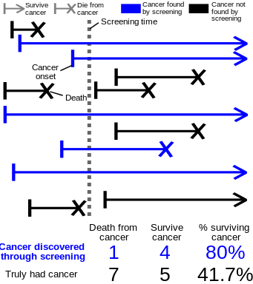
Length Time Bias and Cancer Screening
Length time bias is that those slower growing cancers with better prognosis are likely caught by screening than those with aggressive cancer
and artificially look like screening have made the prognosis better.
http://en.wikipedia.org/wiki/Length_time_bias
Notes:
Length time bias is that those slower growing cancers with better prognosis are likely caught by screening than those with aggressive cancer and artificially look like screening have made the prognosis better.
Many screening tests involve the detection of cancers. It is often hypothesized that slower-growing tumors have better prognoses than tumors with high growth rates. Screening is more likely to detect slower-growing tumors (due to longer pre-clinical sojourn time), which may be less deadly. Thus screening may tend to detect cancers that would not have killed the patient or even been detected prior to death from other causes.
[edit]

Slide 34
Outcome of HCC Surveillance
18,816 people with HBV infection or history of chronic hepatitis in urban Shanghai, China enrolled
  Surveillance group offered US and AFP every 6 months (n = 9373)
  Control group received no surveillance (n = 9443)
37% reduction in mortality
Rate ratio:
1.37 (95% CI; 0.99-1.89)
Rate ratio:
0.63 (95% CI; 0.41-0.98)
300
300
250
223.7
250
200
200
Total Incidence (per 100,000)
163.1
Total Mortality (per 100,000)
150
150
131.5
100
100
83.2
50
50
0
0
Surveillance
Control
Surveillance
Control
Zhang BH, et al. J Cancer Res Clin Oncol. 2004;130:417-422.
Notes:
This slide shows outcome of HCC surveillance Ultrasonography and AFP in China.
More than 9000 patients received no HCC surveillance, the remaining 9000 surveillance with Ultrasonography and AFP.
The percent values show 3 years survival rates.
The reduced HCC related mortality by 37% has been determined.

Slide 35
Outcome of HCC Surveillance
18,816 people with HBV infection or history of chronic hepatitis in urban Shanghai, China enrolled
  Surveillance group offered US and AFP Q 6 months (n = 9373)
  Control group received no surveillance (n = 9443)
0.8
Rate ratio:
0.63 (95% CI; 0.41-0.98)
Control
300
0.6
Surveillance
250
37% reduction in mortality
200
0.4
Survival Probability, %
Total Mortality (per 100,000)
150
131.5
0.2
100
83.2
50
0.0
0
0
1
2
3
4
5
Screened
Control
Time (Yrs)
Zhang BH, et al. J Cancer Res Clin Oncol. 2004;130:417-422.
Notes:
Adherence was less than 60%

Slide 36
FDA Cleared HCC Risk Biomarkers for Surveillance and
Early Detection
AFP
AFP-L3%
DCP (PIVKA-II)
AFP: alpha-fetoprotein
AFP-L3: Lectin-reactive alpha-fetoprotein
PIVKA-II: proteins induced by vitamin K absence or antagonist-II
DCP: Des-gamma-carboxy prothrombin

Slide 37
AFP and AFP-L3
AFP is a protein with a single carbohydrate chain.
Serum levels of AFP elevate in patients with liver injury and cancer.
AFP-L3, an isoform of AFP, has an additional fucose residue.
AFP-L3% is the ratio of AFP-L3 to total AFP (AFP-L1 and L3) as a percentage. The AFP-L3 (%) has been reported to be highly specific for HCC compared to AFP concentration in clinical practice.
Fucose
GDP
GDP
Fucose
FUT8
AFP-L1
AFP-L3
Sia
Gal
GlcNac
Man
Notes:
AFP is a well known HCC tumor marker, and AFP-L3 is its isoform.
As shown here, AFP has a single sugar chain moiety on the protein.
AFP, although it is widely used in the world as a tumor marker, the
concentration increases even in the case of benign liver diseases.
On the other hand, AFP-L3, which has a fucose residue on the sugar chain,
is known to be secreted specifically in liver cancer.
Due to the addition of the fucose residue, this molecule becomes reactive to LCA lectin.
AFP-L3%, the fraction of AFP-L3 over the total AFP is used as a tumor marker for HCC.
AFP-L3% has been measured by the manual lectin affinity electrophoresis method or
the automated system, called LiBASys which uses ion exchange column chromatography
for bound and free separation.

Slide 38
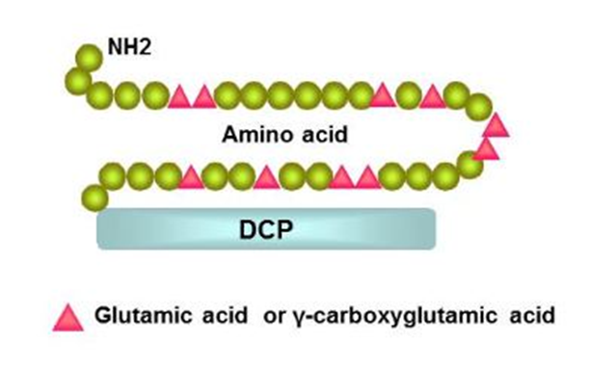
PIVKA-II/DCP
Des-CarboxyProthrombin is a precursor form of prothrombin, a coagulation protein.
PIVKA-II: protein induced by vitamin K absence (II)
In normal liver, prothrombin undergoes post-translational carboxylation before release into the peripheral blood. The carboxylation converts specific amino-terminal glutamic acid residues to gamma-carboxyglutamic acid in the presence of Vitamin K.
The vitamin K dependent carboxylase responsible for the carboxylation is absent in many HCC cells, and an abnormal prothrombin with all or some of unconverted glutamic acid is secreted instead.

Slide 39
FDA Cleared: Intended Use
The Wako DCP and AFP-L3% assay are intended as a risk assessment test for the development of hepatocellular carcinoma (HCC) in patients with chronic liver diseases (CLD).
Elevated AFPL3% values (≥ 10%) have been shown to be associated with a seven-fold increase in the risk of developing HCC within the next 21 months.
Patients with elevated serum AFPL3% should be more intensely evaluated for evidence of HCC according to the existing HCC practice guidelines in oncology.

Slide 40
Inclusion of AFP-L3% & DCP (PIVKA-II) Improves
Early Risk Assessment for HCC
 | Primary Tool | Sensitivity | Specificity | Conclusions
Colli et al (2006)¹ | Ultrasound | 48% (95% CI 34-62%) | 97% (95% CI 95-98%) | “Ultrasound is…insufficiently sensitive to detect HCC in many cirrhotics or to support an effective surveillance program.”
Singal et al (2012)² | Ultrasound | 43.9% | 91.5% | Ultrasound is suboptimal when used alone
Volk et al (2007)³ | AFP, AFP-L3 & DCP | 84% | 94% | Combined use of AFP, AFP-L3 and DCP results in enhanced detection of HCC with minimal false positives
Hann et al (2013)⁴ | AFP, AFP-L3 & DCP | 83% | 91%
1. Colli A, et al. Am J Gastroenterol 2006;101:513-23.
2. Singal et al. Cancer Epidemiol Biomarkers Prev. 2012;21:793-9
3. Volk ML, et al. Cancer Biomarkers 2007;3:79-87
4. Hann HW, et al. DDW 2013 Poster Tu 1048
Notes:
Slide 11- Improvement of Surveillance when all 3 biomarkers are included in the surveillance program.
The inclusion of AFP-L3 and DCP to the minimum recommended surveillance can improve the sensitivity and specificity of risk assessment for HCC.
The AASLD guidelines recommend ultrasound every 6 months but the literature has demonstrated that the sensitivity and specificity of US alone is insufficient as a standalone surveillance modality and is relatively insensitive.
The literature further demonstrates that the utilization of the serum biomarkers AFP, AFP-L3 and DCP with imaging enhances the ability to assign risk for the development of HCC and thus aid in the earlier detection of tumors.

Slide 41
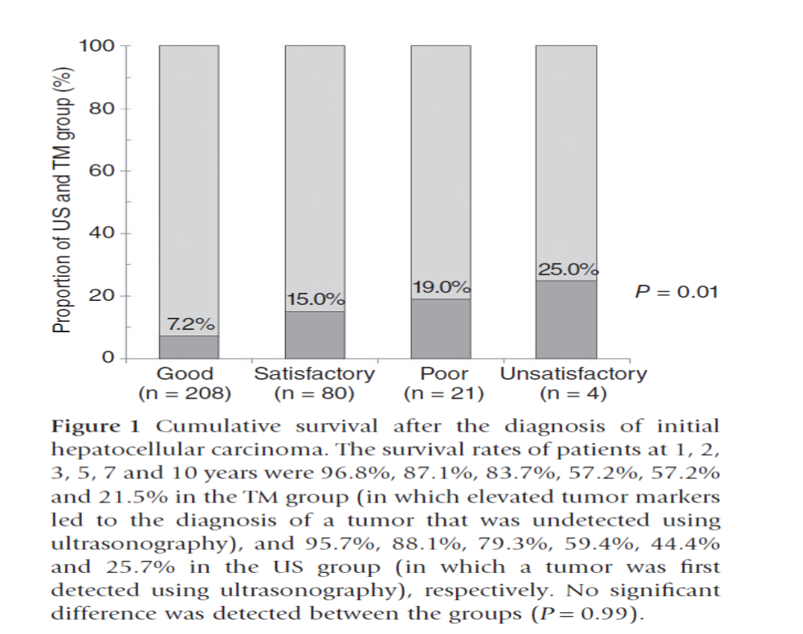
Utility of biomarkers in poor quality US exams
US = Dx by US exam
TM = Early detection by
HCC Tumor markers
Mikami, Hepatology Research 2015

Slide 42
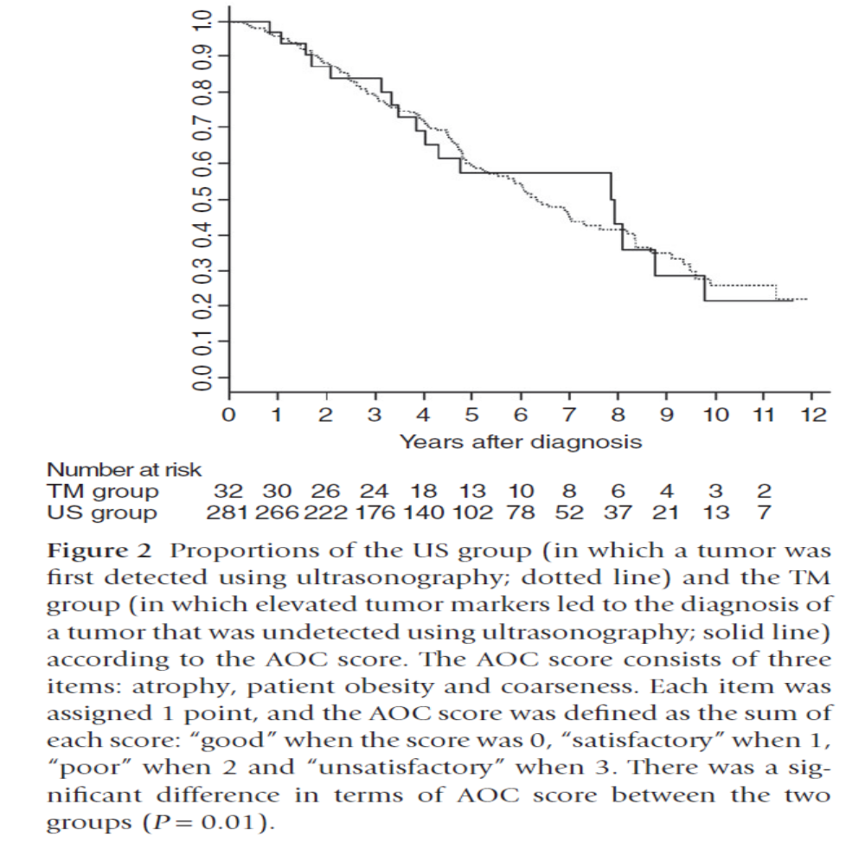
Detection of HCC using triple Biomarkers (TM) in poor quality US is equivalent to high quality US
P= 0.001
AOC better for tumor markers
Mikami, Hepatology Research 2015

Slide 43
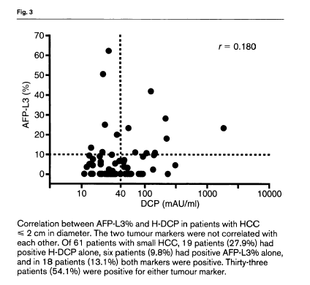
AFP-L3% and DCP Are Independent Biomarkers
Notes:
Here is the correlation between AFP-L3 and DCP in patients with HCC less than 2 cm in diameter.
AFP-L3 and DCP of each patient was plotted on this graph.
These two markers were not correlated each other and independently associated with HCC.

Slide 44
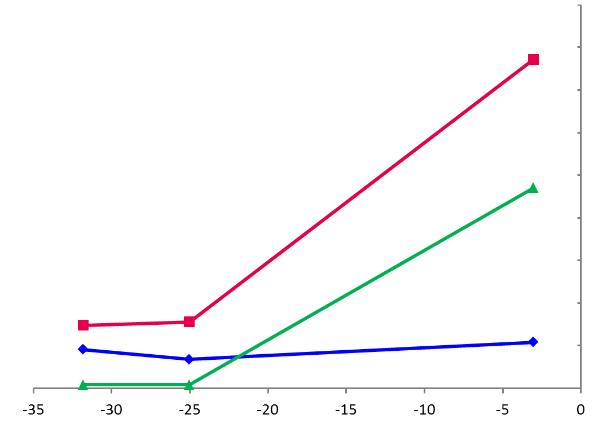
Case 1 - Risk Assessment Using AFP-L3% and DCP Elevation
AFP-L3% and DCP were increased before HCC detection in some patients who had
a low (normal) AFP level.
--------------------------------------------------------Adding AFP-L3% and DCP as risk markers to conventional surveillance tools such as AFP and ultrasound can increase chances of early detection of HCC.
38.6%
Level of Biomarker
17.65 ng/mL
AFP-L3%
Normal: <10%
Cut-off
Level
7.4%
7.8%
AFP
Normal: <20 ng/mL
10.8 ng/mL
9.1 ng/mL
6.8 ng/mL
0.30 ng/mL
0.32 ng/mL
DCP
Normal: <7.5 ng/mL
Months Before Diagnosis by Imaging
2 nodules at diagnosis:
4.9 and 4.1 cm
Hann HWJ Med Microb Diagn 2014, 3: 130
Notes:
AFP-L3 and DCP were able to detect evidence of HCC risk when AFP was normal and ~2 years prior to imaging.
The data shown is from a study conducted at Thomas Jefferson University in which assay data from the biomarker panel of AFP, AFP-L3 and DCP were compared with Magnetic Resonance Imaging (MRI) for surveillance of HCC.
Both AFP-L3 and DCP increased 15-24 months prior to tumor detection by MRI.
MRI is more sensitive than the AASLD recommended surveillance imaging modality of ultrasound.
It is also important to note that in the data shown, AFP levels were in the normal range.
The AFP-L3 assay is a particularly good measure of early risk of tumor development when AFP is normal in at risk patients.

Slide 45
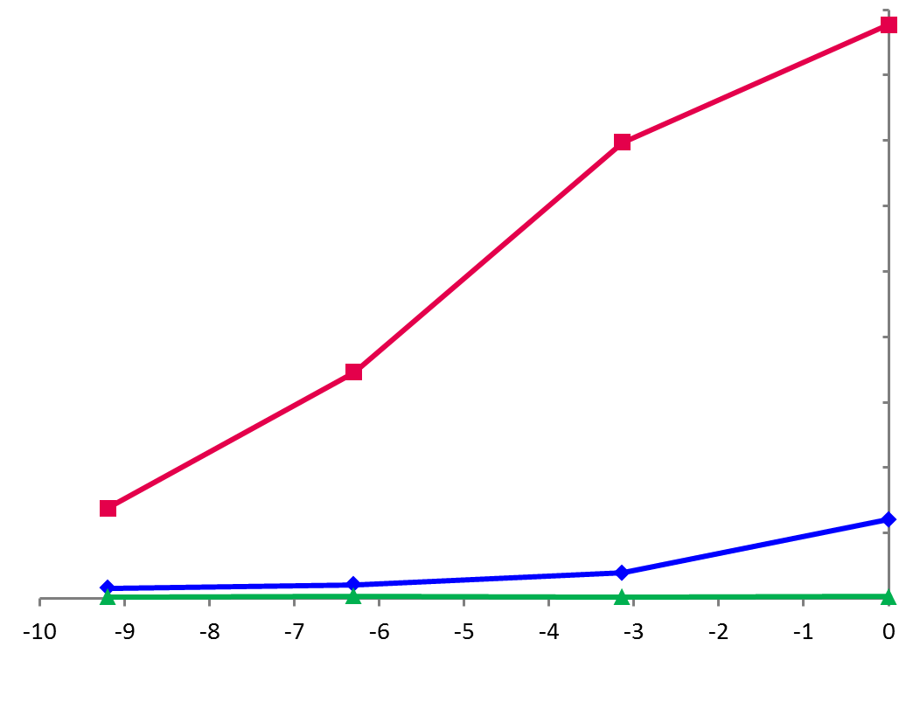
Case 2 - Risk Assessment Using AFP-L3% Elevation
87.7%
Only AFP-L3% increased before HCC diagnosis by MRI.
-----------------------------------------------------
Elevation of AFP-L3% indicates higher risk of developing HCC and can be a trigger to do CT/MRI for early detection.
69.7%
Level of Biomarker
34.6%
AFP-L3%
Normal: <10%
13.8%
24.1 ng/mL
AFP
Normal: <20 ng/mL
7.9 ng/mL
Cut-off
Level
3.2 ng/mL
4.3 ng/mL
DCP
Normal: <7.5 ng/mL
0.17 ng/mL
0.26 ng/mL
0.19 ng/mL
0.23 ng/mL
Single nodule at diagnosis: 0.9 cm
Hann HWJ Med Microb Diagn 2014, 3: 130
Months Before Diagnosis by imaging
© Copyright 2014 Wako Life Sciences, Inc. 4/1/2014
Notes:
Another case.
Only AFP-L3 increased before HCC diagnosis by MRI.
AFP was slightly elevated at diagnosis but its value was 24 ng/mL that was not so high comparing the cut-off level.
DCP level was quite low.

Slide 46
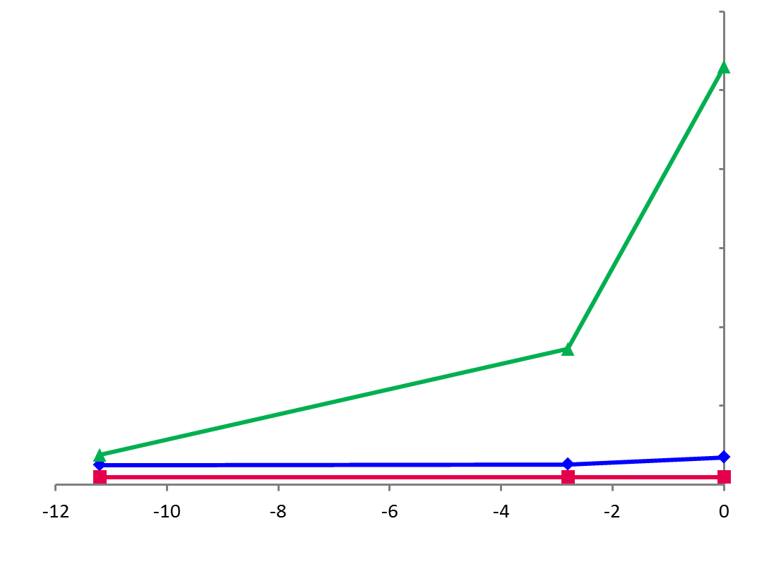
Case 3 - Risk Assessment Using DCP (PIVKA-II) Elevation
Some patients have an early AFP-L3% elevation, and some have DCP. DCP elevation represents a different feature of HCC development than AFP-L3%.
-------------------------------------------------------Combined use of DCP and AFP-L3 can increase the sensitivity of HCC identification.
19.86 ng/mL
Level of Biomarker
Cut-off
Level
6.45 ng/mL
DCP
Normal: <7.5 ng/mL
AFP
Normal: <20 ng/mL
1.43 ng/mL
2.6 ng/mL
3.5 ng/mL
2.5 ng/mL
AFP-L3%
Normal: <10%
Single nodule at diagnosis: 1.3 cm
0.5%
0.5%
0.5%
Months Before Diagnosis by Imaging
Hann HWJ Med Microb Diagn 2014, 3: 130
© Copyright 2014 Wako Life Sciences, Inc. 4/1/2014
Notes:
Some patients have an early AFP-L3 elevation, and some have DCP only.
As shown on the prior slide, AFP-3 and DCP are independent markers.
Therefore, these biomarkers should be measured at the same time for patients at high risk not to miss HCC development.

Slide 47
Combined HCC Biomarker Usage Yields a More Complete Assessment of Probability of Current Cancer
If HCC biomarkers are used prior to imaging:
In this study of 74 patients, the use of AFP alone would have detected 45 HCC cases and missed 29 cases of HCC
All Negative
7
(9.5%)
AFP-L3 Positive
15
(20.3%)
4
(5.4%)
15
(20.3%)
 | Cut-off point | Positive cases
AFP | ≥ 20 ng/mL | 45 | (60.8%)
AFP-L3 | ≥10 % | 49 | (66.2%)
DCP (PIVKA-II) | ≥ 7.5 ng/mL | 29 | (39.2%)
Combination of AFP, AFP-L3, and DCP | Same as above | 67 | (90.5%)
15
(20.3%)
DCP Positive
3
(4.1%)
AFP Positive
8
(10.8%)
7
(9.5%)
FDA submission data for uTASWako i30
Notes:
The use of all 3 HCC serum based biomarkers provides the ability to assign risk more comprehensively.
HCC is a heterogeneous cancer.
In the data collected in this venn diagram, AFP alone would have missed nearly 40% of HCC detected.
However, by utilizing a panel combining AFP, AFP-L3 and DCP, nearly 91% of HCC were detected.
Using all three biomarkers together provides for a more comprehensive ability to assign risk for the development of HCC than any one biomarker alone.

Slide 48
Sensitivity of Biomarkers for HCC Detection
Depends On Stage And Size
Study from Ogaki Municipal Hospital
HCC patients with AFP less than 20 ng/mL (n=270)
 |  | n | AFP-L3 (%) | PIVKA-II (%) | AFP-L3% and/or PIVKA II (%)
TNM Stage | I | 89 | 34.8 | 20.2 | 44.9
 | II | 127 | 42.5 | 57.5 | 71.7
 | III | 47 | 53.2 | 53.2 | 74.5
 | IV | 7 | 28.6 | 71.4 | 85.7
Size (cm) | ≤ 2 | 123 | 36.6 | 24.4 | 48.8
 | > 2 and ≤ 3 | 63 | 46.0 | 52.4 | 65.1
 | > 3 and ≤ 5 | 52 | 44.2 | 63.5 | 80.8
 | > 5 | 32 | 46.9 | 78.1 | 90.6
>5 %
>40 mAU/mL
Cancer Sci. 2011;102:1025-31.
Notes:
The sensitivity of tumor markers depends on the stage of the cancer.
This table shows sensitivity of tumor markers in HCC patient with AFP less than 20ng/mL.
You can find that the higher sensitivity of AFP-L3 in the early stage.
And the sensitivity of PIVKAⅡ is higher in the late stage.

Slide 49
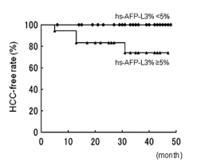
Prediction for risk of HCC Development with AFP-L3%
- 74 patients with chronic hepatitis or cirrhosis.
- Surveillance serum sampling for 32.8 ±12.3 (5 - 48) months.
CT, MRI or US at 3- to 6-month intervals in pts with cirrhosis
US at 6- to 12-month intervals in pts with hepatitis
AFP-L3 <5%
AFP-L3 ≥5%
HCC-free rate (%)
P = 0.0012
Months until HCC detection
Oncol Rep. 2011;26:1227-33.
Notes:
This is the clinical study from Japan.
Patients who had no HCC were followed after blood collection to do AFP-L3 testing.
The HCC free rate of patients with AFP-L3 greater than 5% was significantly lower than that in patients with low level of AFP-L3.
In the group with AFP-L3 less than 5%, no patients developed HCC during the follow-up period.
Elevation of AFP-L3 can predict high risk of HCC development.

Slide 50
We Use Three Established Blood Tests
Widely Used In Japan For Diagnosis And Surveillance
Why choose these three?
1. Can be measured on the same system
2. FDA-approved for HCC ‘risk’
3. Stable & well-characterised
4. Extensive and well-annotated data have been recorded and are available to us.
Alpha fetoprotein (‘AFP’)
AFP-L3: a sub (iso)-form of AFP (‘L3’)
Des-γ-carboxy-prothrombin (‘DCP’)

Slide 51
A New Approach To The Application Of Biomarkers To HCC Diagnosis
The GALAD Model
G – Gender
A – Age
L – AFP- L3
A – Alpha-fetoprotein
D – Des-carboxy prothrombin
‘GALAD’
GALAD SCORE Z = -10.32 + 0.10 x [Age] + 1.39 x [Gender] + 2.43 x log[AFP] + 0.040 x [AFP-L3] + 1.45 x log[DCP]
  Rigorous statistical methodology
  Treats variables in their continuous form - no dichotomisation
  Then extensive validation, internally and externally
Decision tool
Information extraction
Digital
Analogue
Johnson et al, Cancer Epi Biom and Prev 2014

Slide 52
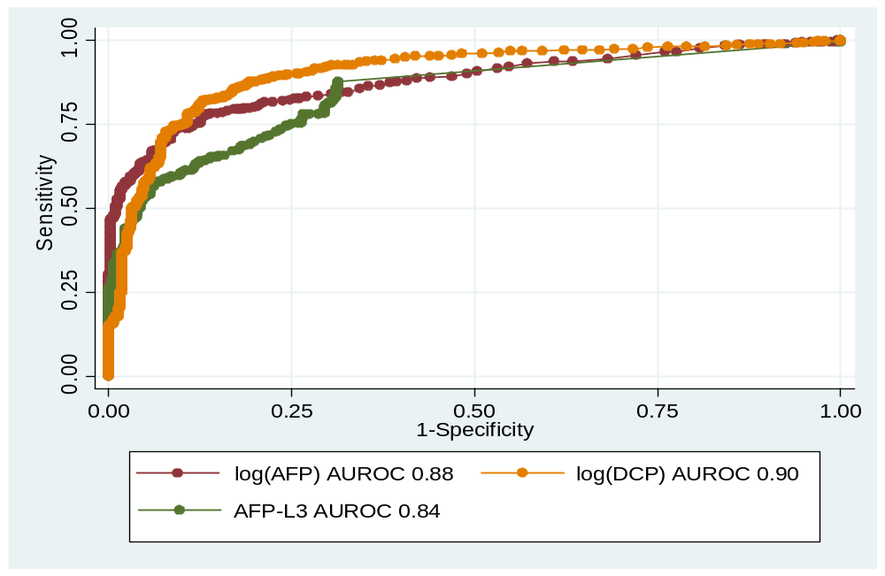
Individual Data - Before The GALAD Model (Japan)

Slide 53
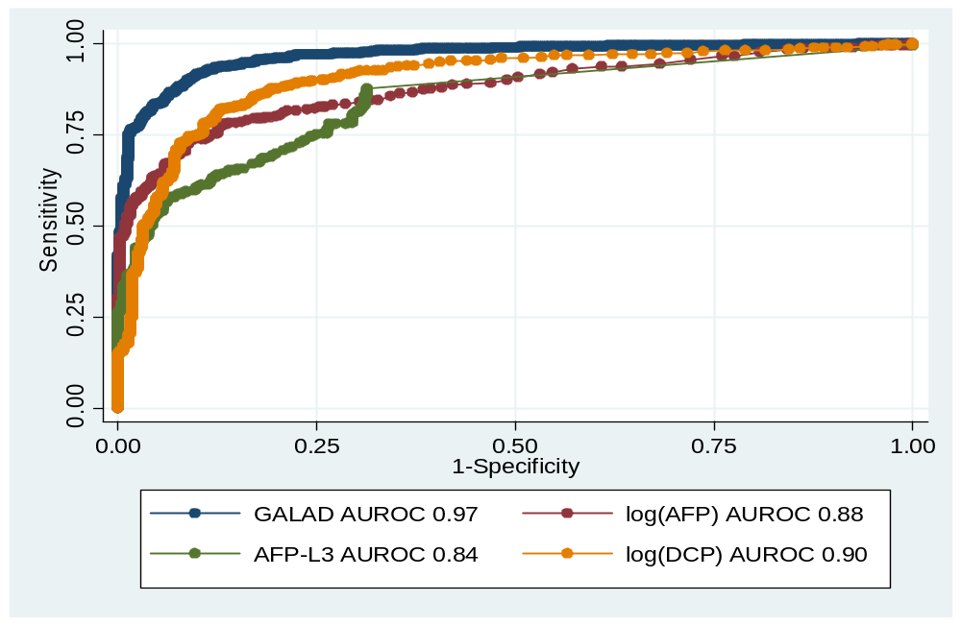
Added Value of The GALAD Model (Japan)

Slide 54
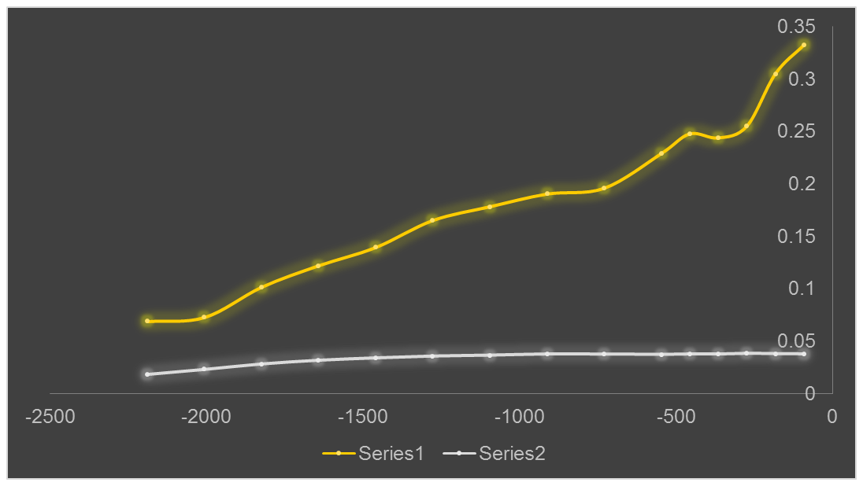
Change In Probability of HCC, according to GALAD
Before Clinical Diagnosis
HCC diagnosis: picked up on screening
(median1.8cm,
90%<3cm)
Patients developing HCC
Probability of HCC
Control subjects – not developing HCC
Time (days) before HCC is picked up on surveillance
Data Courtesy of Dr T Kumada and Dr H Toyoda, Ogaki, Japan
Analysis by Emily and Oliver de Groot

Slide 55
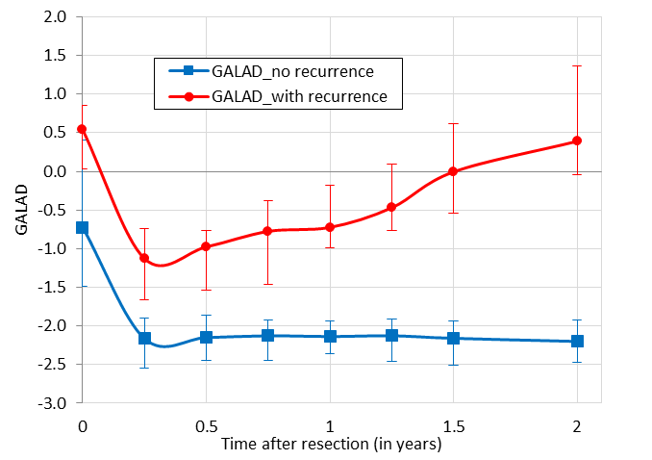
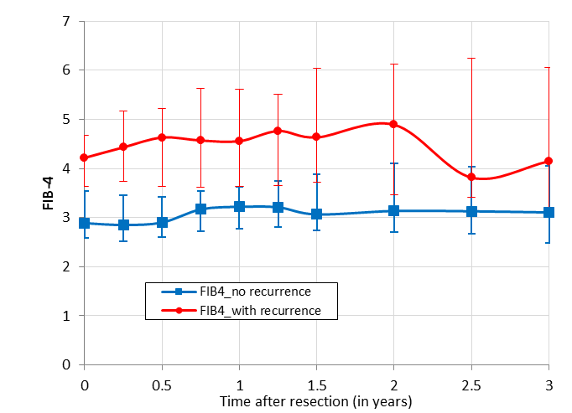
Changes After Resection With Curative Intent According To Recurrence Within Two Years
Johnson et al., EASL 2017

Slide 56
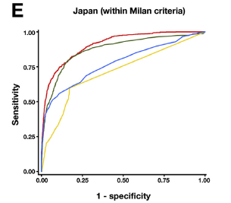
Combination Biomarkers
Validation of GALAD – Gender, Age, L3, AFP, DCP in 7155 patients – 2430 with HCC and 4725 with CLD from UK, Japan, Hong Kong & Germany
Japanese Cohort (within Milan
GALAD
AUROC 0.91
AFP
AUROC 0.87
Sensitivity
DCP
AUROC 0.78
AFP-L3
AUROC 0.71
1-Specitivity
Combination performs better than each individual biomarker in large retrospective cohorts for all HCC and curable HCC
Berhane Clinical Gastro Hep 2016

Slide 57
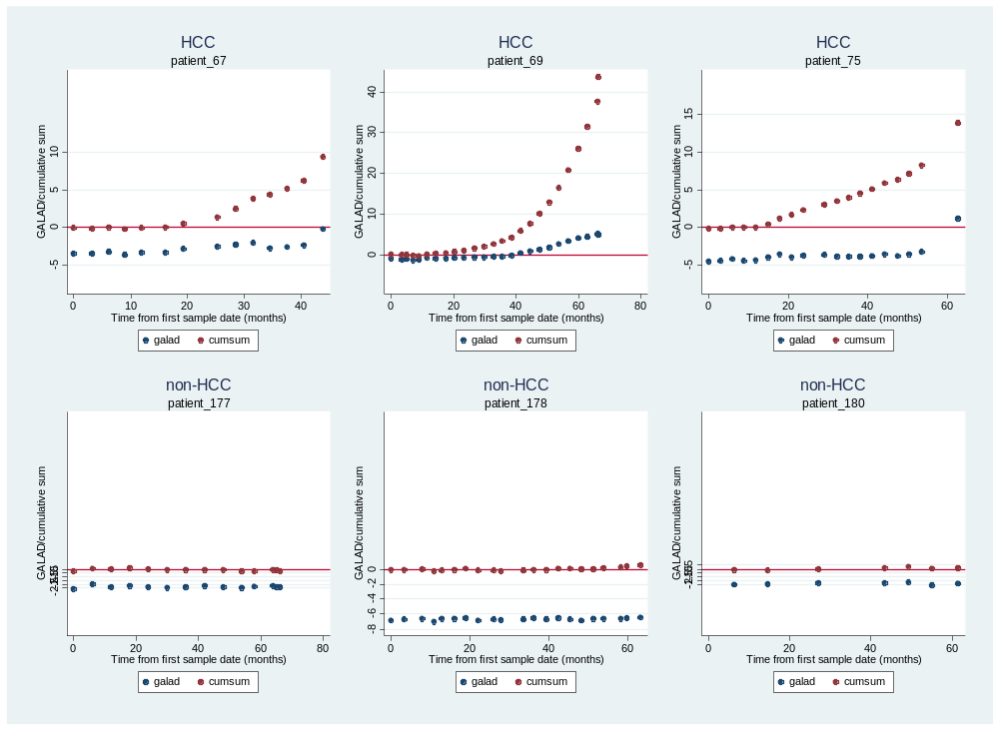
Combining the Absolute And Dynamic* Aspects of GALAD
Towards ‘Personalised Diagnostics’
HCCs
Non-HCCs
*Statistical control process methodology
Berhane et al., EASL 2017

Slide 58
Test Characteristics Prospective RT of US vs US and BM
Group A - US
 | HCC | No HCC
US positive | 4 | 21 | 25
US negative | 5 | 1744 | 1753
 | 9 | 1765 | 1774
PPV = 16%
NPV = 99.4%
Sensitivity = 44.4%
Specificity = 98.8%
False positive rate = 1.2%
Group B – US + BM
 | HCC | No HCC
US or BM positive | 12 | 37 (BM) + 20 (US) | 69
US & BM negative | 1 | 1621 | 1622
 | 13 | 1678 | 1774
PPV = 17%
NPV = 99.9%
Sensitivity = 92.3%
Specificity = 96.6%
False positive rate = 3.4%
FELD AASLD 2017

Slide 59

Table 2. Sensitivity (TPR) and FPR for Early Detection of HCC within 6, 12, and 24 months
 | HCC within 6 months (Cases: 17, Controls: 511) |  | HCC within 12 months (Cases: 20, Controls: 508) |  | HCC within 24 months (Cases: 20, Controls: 508)
 | TPR | FPR | TPR | FPR | TPR | FPR
AFP>20 ng/mL | 0.24 | 0.06 | 0.30 | 0.06 | 0.30 | 0.06
AFP-L3%>10% | 0.41 | 0.05 | 0.40 | 0.04 | 0.40 | 0.04
DCP>2 ng/mL | 0.41 | 0.11 | 0.40 | 0.11 | 0.45 | 0.11
Either: AFP>20 ng/mL, AFP-L3%>10% or DCP>2 ng/mL | 0.59 | 0.20 | 0.65 | 0.19 | 0.65 | 0.19
GALAD> -0.63 | 0.82 | 0.28 | 0.85 | 0.27 | 0.85 | 0.27

Slide 60
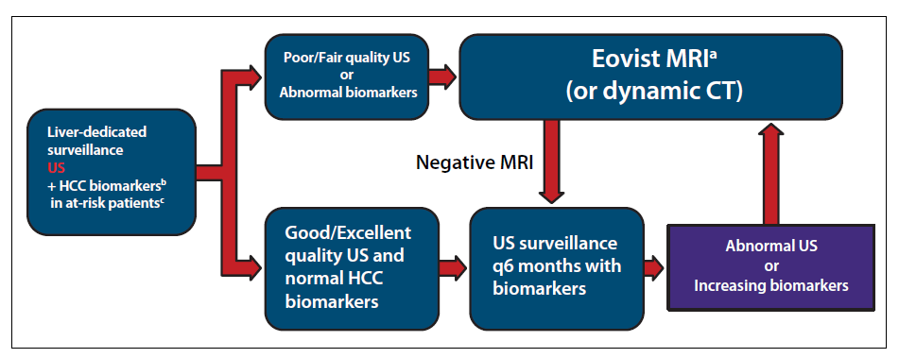
A Proposed Liver Surveillance Algorithm
tests AFP-L3%/DCP (HCC serum biomarkers); *AASLD Guidelines 2009; # see LI-RADS.
AASLD = American Association for the Study of Liver Diseases; AFP = alpha-fetoprotein; CT = computed tomography;
DCP = des-gamma-carboxy prothrombin; HCC = hepatocellular carcinoma; LI-RADS = Liver Imaging Reporting and Data System;
MRI = magnetic resonance imaging; US = ultrasound.
Gish, R., Gastroenterology & Hepatology, 2014; 10;2:121-123.
Notes:
Slide 14- Dr. Gish’s surveillance algorithm
The best way to monitor at risk patients for HCC development is through a dedicated surveillance program. The AASLD guidelines are a good starting point but the data in the literature shows that ultrasound alone is insufficient. Augmenting imaging with serum based biomarkers can provide for a great ability to catch tumors early enough to apply potentially curative therapies.
I (Dr. Gish) have recently published a surveillance algorithm that utilizes all the methodologies at my disposal to detect HCC as early as possible.
Every 6 months, my patients receive both an ultrasound (ideally from a dedicated or specifically trained liver sonographer) and an HCC risk panel that includes AFP, AFP-L3 & DCP.
If all the tests, biomarkers and good or better quality ultrasound, are negative then the patient will return in 6 months for their next serial surveillance point.
If however, any of the tests are positive, biomarkers exceed FDA cleared thresholds or the ultrasound imaging shows a suspicious nodule or is of fair or less quality , then the patient is recommended to receive a diagnostic quality contrast enhanced MRI or contrast enhanced CT.
If the diagnostic imaging turns out negative then the patient returns to their normal surveillance cycle.
If the diagnostic imaging is positive for HCC, then depending on the size and stage of the tumor, then the appropriate therapy will be recommended.
Even in the case where biomarkers are normal but show an increasing trend time-point over time-point, we may recommend a diagnostic imaging session as well.

Slide 61
When to stop HCC surveillance ?
? Never ?
When biomarkers are normal and F2 fibrosis or less ?
Viral cure or control ?
Case by case !!

Slide 62
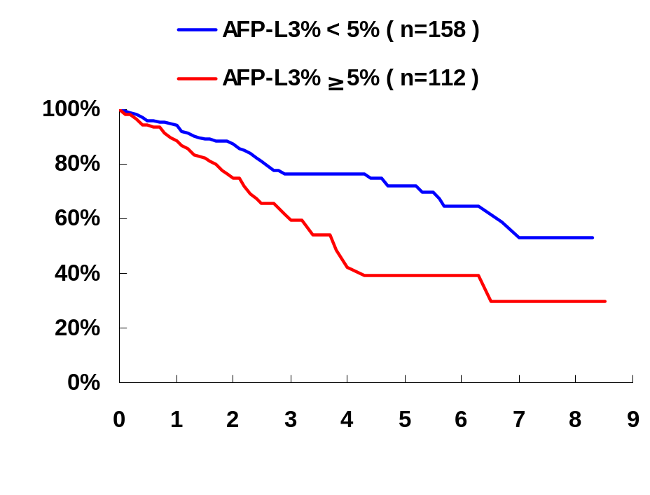
Pre-operative in HCC patients :
AFP-L3% Predicts Poor Outcome
The study from Ogaki Municipal Hospital
Patients with resection, RFA, or TACE (n=270)
Survival rate
AFP-L3 <5% (n=158)
AFP-L3 ≥5% (n=112)
p < 0.001
Years after diagnosis
Cancer Sci. 2011;102:1025-31.
Notes:
This is the data from another hospital in Japan.
HCC patients were divided into two groups based on AFP-L3 values at diagnosis: AFP-L3 5% and over, and AFP-L3 less than 5%.
The survival rate of patients with AFP-L3 ≥5% was significantly lower than that of patients with AFP-L3 less than 5%.
Elevated AFP-L3 at diagnosis is also associated with poor outcome.

Slide 63
Post-operative AFP-L3% Predicts Recurrence in patients with HCC
The study from Toranomon Hospital, Japan
HCC patients who received resection (n=93)
100
80
AFP-L3 ≥5%
60
AFP-L3 <5%
Cumulative recurrence rate (%)
40
20
p < 0.001
0
0
5
10
Years after treatment
Hepatol Res. 2011;41:1036-45.
Notes:
AFP-L3 was measured after resection.
The recurrence rate of patients with elevated AFP-L3 was significantly higher than that of patients with AFP-L3 less than 5%.
Elevated AFP-L3 after treatment can predict HCC recurrence.

Slide 64
HCC Biomarkers Can Help Patient Management
HCC biomarkers are useful for:
  Risk assessment under surveillance
  Early detection and prognosis
  Stage of disease
  Vascular invasion
  Differentiation of tumor
  Prediction of recurrence
Combined use of AFP, AFP-L3% and PIVKA-II can help patient management in conjunction with imaging modalities.
Biomarkers
Imaging
Ultrasound

Slide 65
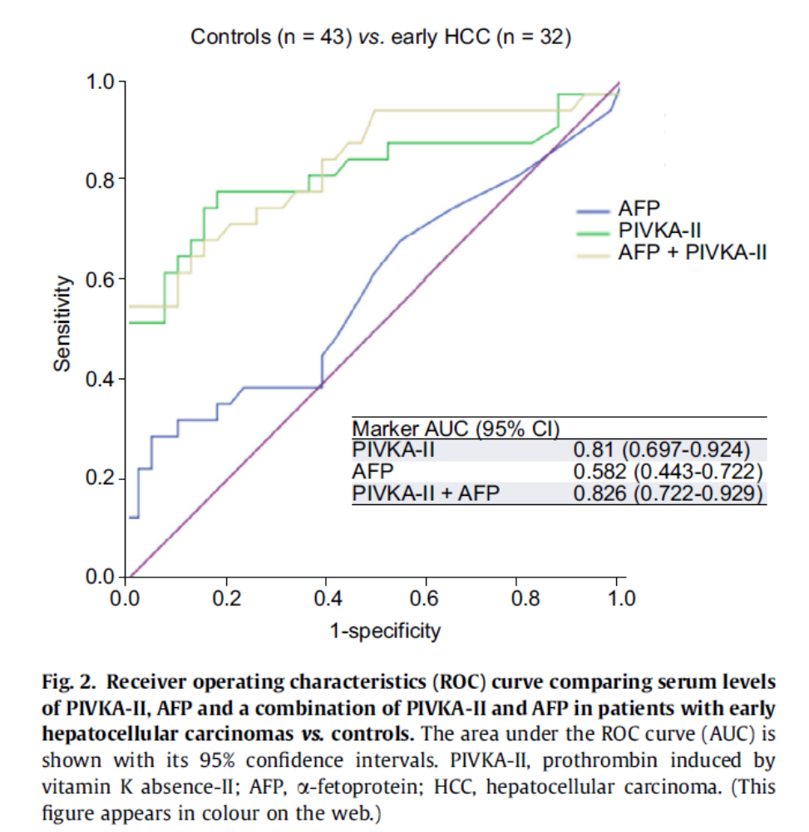
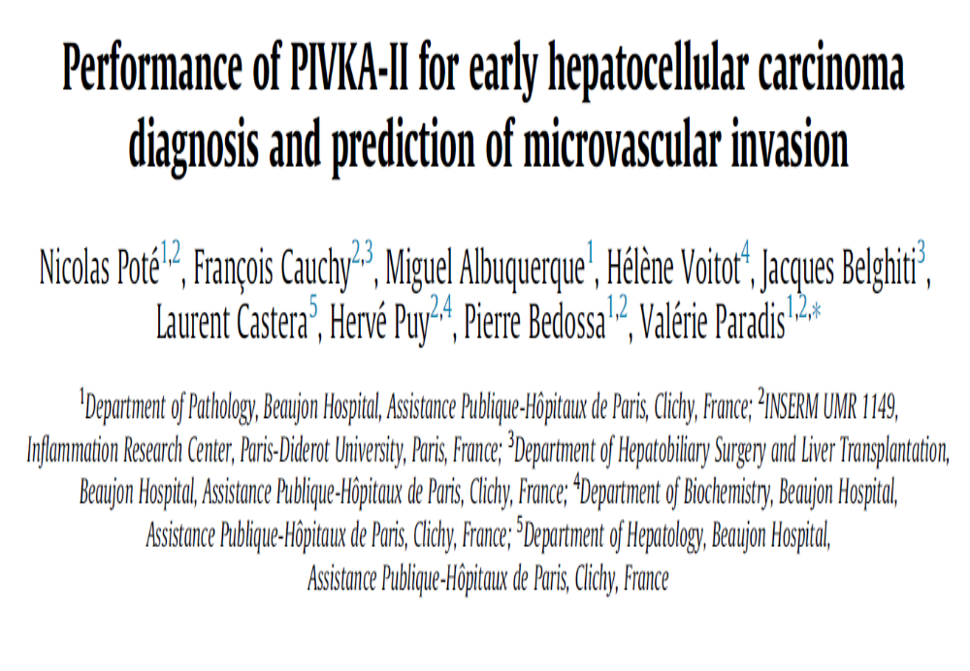
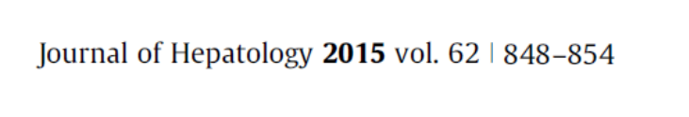
PIVKA-II (DCP) : correlation with MVI

Slide 66
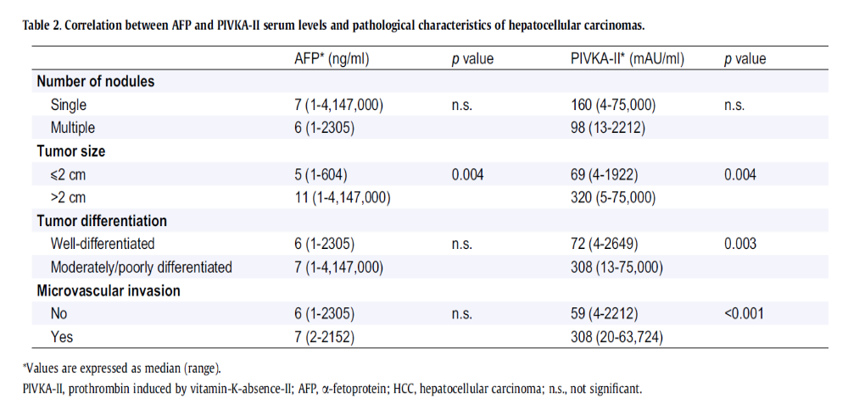
AFP and PIVKA-II (DCP) and histology

Slide 67
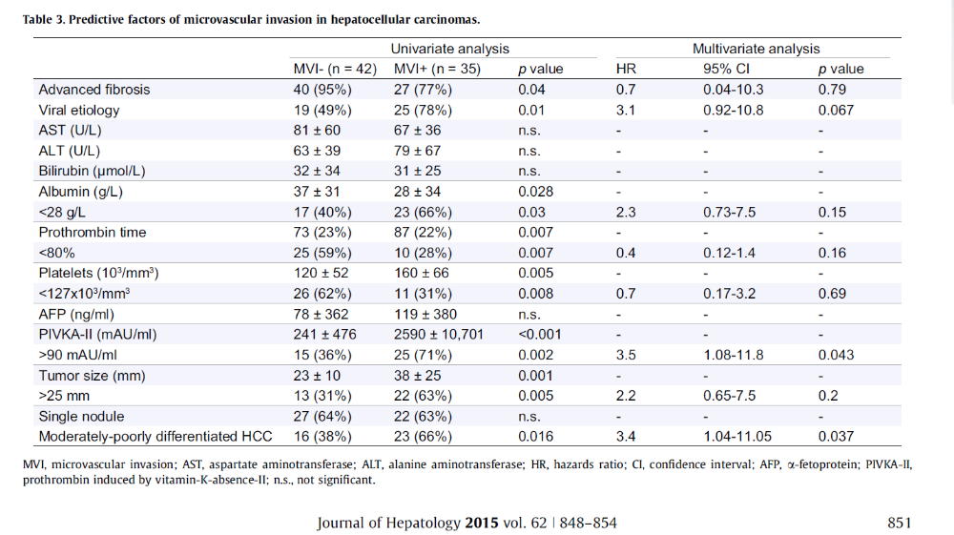
Prediction of MVI

Slide 68
AFP, AFP-L3% and DCP levels during sorafenib treatment in patients with advanced HCC
Study design | Results (2)
Evaluation of AFP, AFP-L3%, and DCP as markers of response in 32 HCC patients treated with sorafenib 400 mg bid (Germany; 2007-2008) Follow-up CT scans performed every 3-4 months to assess tumor response | Disease control rate (DCR) for all patients: was 35% DCR of patients without rising AFP during sorafenib therapy was 38% DCR was 67%/100% for patients without rise of DCP and/or AFP-L3% respectively
Results (1) | Authors' conclusions
14/32 (44%) had all 3 markers significantly elevated; 1 pt had no elevated markers DCP elevated above ULN in 29/32 (91%) AFP elevated in 22/32 patients 16/22 had elevated AFP-L3% | Monitoring of AFP, AFP-L3%, and DCP may provide a readily available marker combination to assess response to sorafenib treatment
Arndt Weinmann*¹, Henning Schulze-Bergkamen², Marcus Wörns¹, Pia Spies¹, Christoph Düber³, Gerd Otto⁴, Annette Shresta¹, Robert Küper⁵, Josef Schurek6, Peter R. Galle¹, Martin Volkmann⁶
¹I Medical Clinic, University Medical Center of the Johannes Gutenberg University Mainz, Mainz, ²Department of medical oncology, National Center for Tumor Diseases, Heidelberg, ³Department of Diagnostic and Interventional Radiology, University Medical Center of the Johannes Gutenberg University Mainz, Mainz, ⁴Department of Transplantation and Hepatobiliopancreatic Surgery, University Medical Center of the Johannes Gutenberg University Mainz, Heidelberg, ⁵Wako Pure Chemical Industries, Ltd., Neuss, 6Labor Prof. Seelig und Kollegen, Karlsruhe, Germany
Weinmann A, et al. ILCA 2009. Abstract P-170.

Slide 69
Case discussion:
42 yo VN man presents with a
3 cm mass in the left lobe of the liver by US confirmed by CT scan
AFP 4
Referred for
TACE followed by RFA, procedures completed
A 2 month follow up CT scan shows a residual lesion in the left lobe consistent with cancer
AFP 3
Patient referred for surgical consult and consideration of liver transplantation

Slide 70
Case discussion: Part II
Diagnosis : HBV
HBV DNA 10^6
platelet count is 160,000
gynecomastia
Alcohol use 2-4 oz per day
EGD: no varices
CT/US show normal PV at 11 mm and spleen at 11.5 cm
Vitamin D level is 19
Cholesterol 201

Slide 71
Case discussion: Part III
Surgical consult completed
No liver donor available for liver transplant
AFPL3% is 5 %
PIVKA-II (DCP) 200 mAU/mL
Surgical resection of left lobe completed
Pathology : microvascular invasion
margins clear of tumor

Slide 72
Case discussion: Part IV
Surgical consult completed
No liver donor available for liver transplant
AFPL3% is 5%
PIVKA-II (DCP) 200 mAU/mL
Surgical resection of left lobe completed
Pathology : microvascular invasion
margins clear of tumor

Slide 73
Case discussion: Part V
Treatment
Entecavir 0.5 mg per day
Vitamin D 2000 IU per day
Pravastatin 20 mg per day
Alcohol abstinence
Follow up with MR/ alt with US every 3 months with AFP, AFP-L3% and PIVKA-II (DCP)
At 24 months after surgery:
MR negative for cancer,
PIVKA-II; 20mAU/mL, AFP; 2 ng/mL, AFP-L3%; 6%

Slide 74
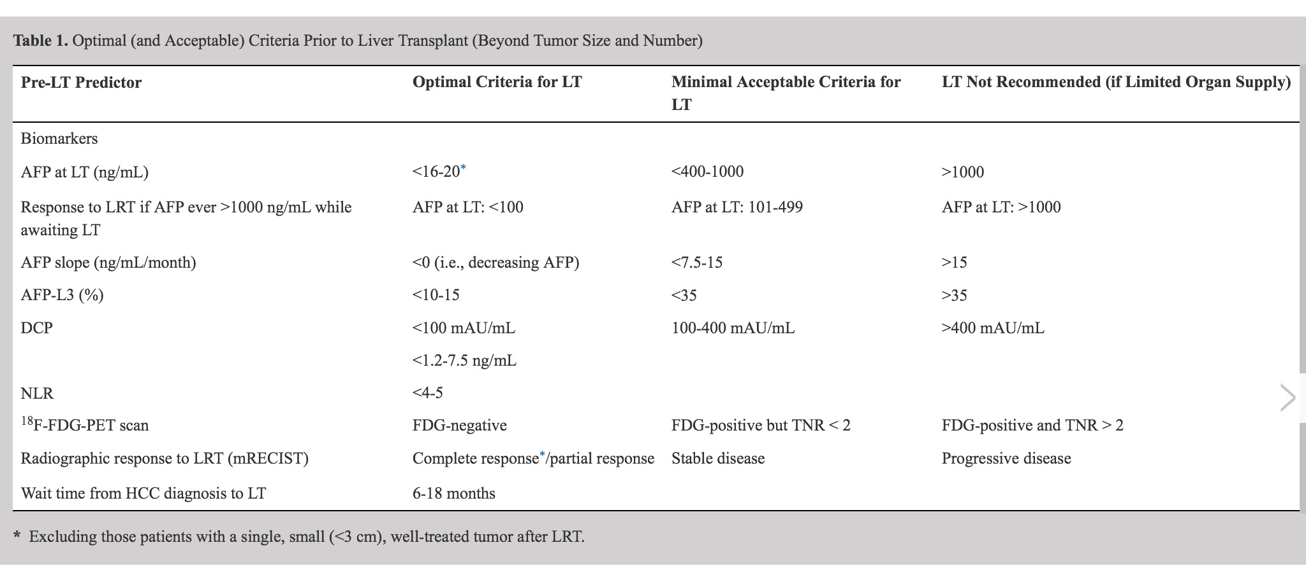

Slide 75
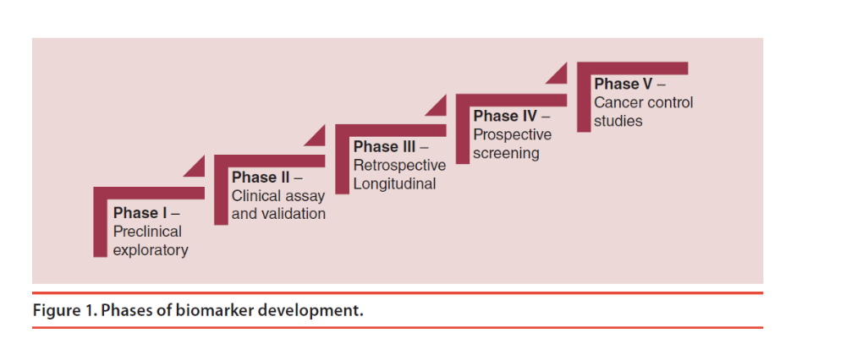
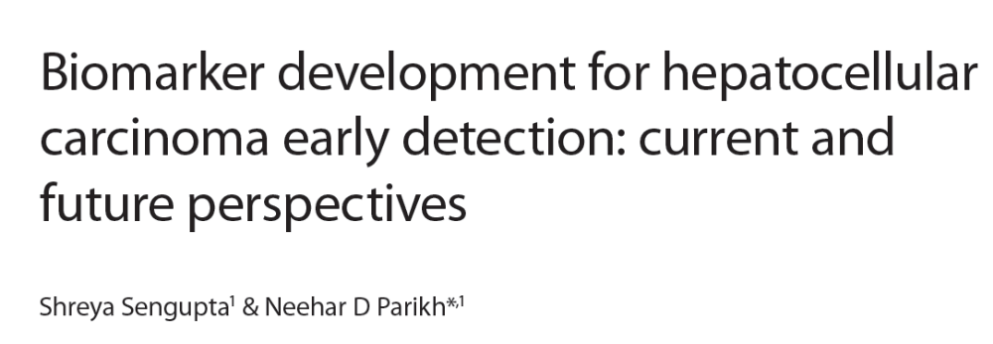
Phases of Biomarker Development

Slide 76
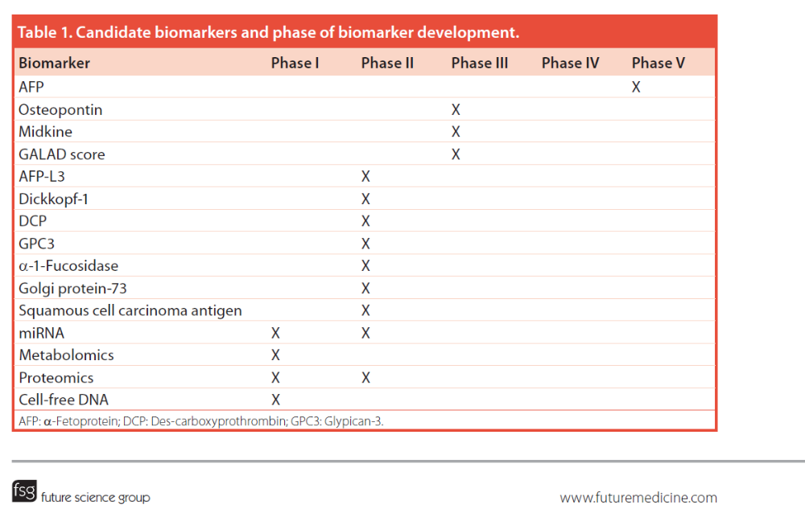

Slide 77
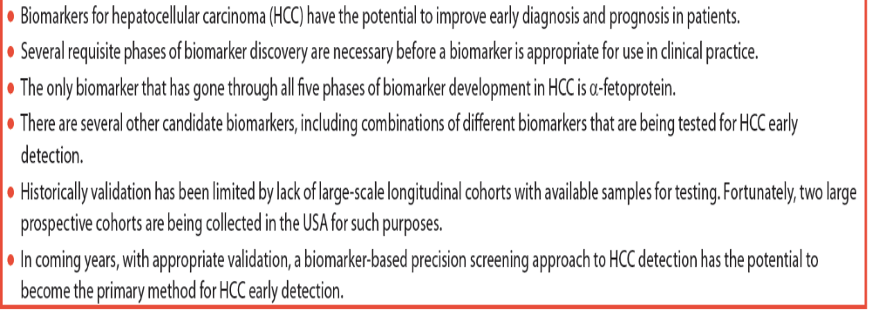

Slide 78
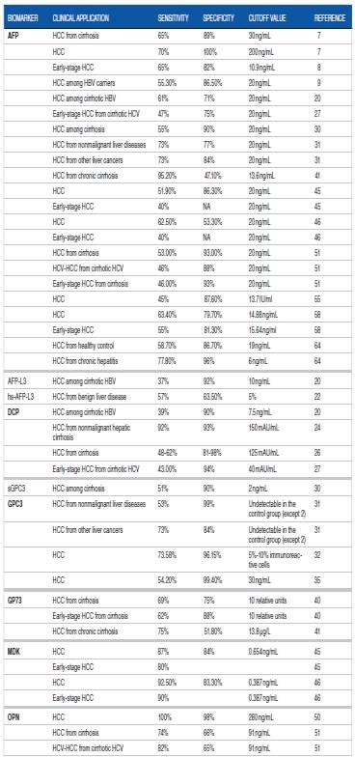
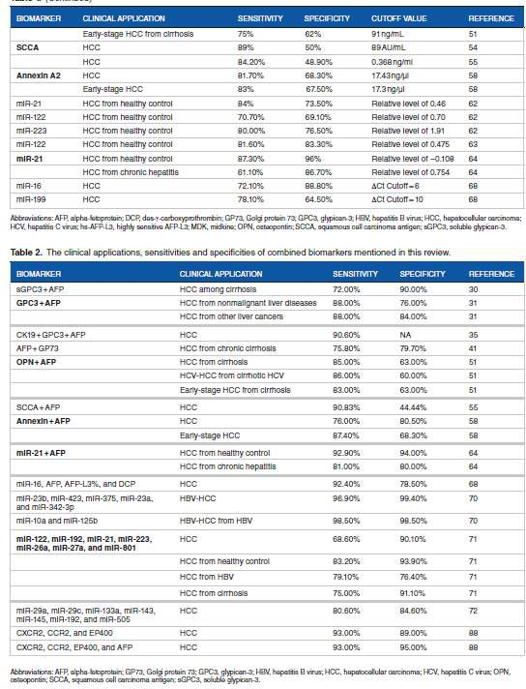
A update of HCC biomarkers: not for diagnosis>>>> early detection

Slide 79
Thank you!

